Slide 1
Key Business Outcomes
Self-Hosted Private Clouds
File Server Access Portals
File Server Migration
Retire Windows File Servers
Accelerate Cloud Migration
NAS Device Support
Business Continuity
Cloud Backup
O365 Integration
Dropbox Replacement
Notes:
File Server Access Portal
Secure File Sharing
Retire Windows File Servers
Accelerate Cloud Migration
Microsoft Integrations
Multi-Site Collaboration
Dropbox Replacement
Cloud Backup

Slide 2
Self-Hosted Private Cloud
Self-Hosted Private Clouds
Cloud Enabled File Servers
Remote NFS Access
VPN Alternative
DFS Replacement
Notes:
Key phrases: private cloud, loud enable file servers, remote access to network file shares, DFS replacement, VPN alternative, multi-site collaboration, remote offices,
Common Verticals: Healthcare, Finance, Legal, Govt.

Slide 3
Self-Hosted Private Cloud Needs
Need to keep data on compliant infrastructure
Want to keep data on private file servers on-premises or in the cloud
Need to maintain high levels of security
Data needs to stay in a certain country or geographical location

Slide 4
Self-Hosted Private Cloud Benefits
Install CS anywhere and use any storage to maintain control and sovereignty.
Rich set of security features like auditing & reporting, encryption, data loss prevention (endpoint encryption, remote wipe), device white listing, etc…
Centralized group policies and access controls based on existing NTFS\AD

Slide 5
Self-Hosted Private Cloud Success Story
MSP (with hosted services)
Simplified User Experience
Cloud File Servers
Healthcare & Compliancy
“For Tilt Technology, the beauty of using CentreStack is that it feels like a seamless part of the process, rather than an entirely separate software. “So far I have not found anyone else that allows us to do that,” Bill said. “

Slide 6
File Server Access Portal
Self-Hosted Private Clouds
Cloudify On-Prem File Servers
Remote NFS Access
VPN Alternative
DFS Replacement
Notes:
Need a way to easily share content with external users
Need a way for remote users to access internal shares
Remote users may not always have access to a network. For example, there could be low bandwidth scenarios or cases where the remote site has certain ports or sites blocked.
May need to work in offline mode and sync when they can connect
Need to maintain centralized access controls and consistency.
Struggling with multiple, inconsistent copies of data

Slide 7
File Server Access Portal Needs
Share content with external users
Remote access to network shares
Low bandwidth performance
Work in offline mode and sync when they can connect
Centralized access controls and consistency.
Avoid multiple, inconsistent copies of data
Notes:
Need a way to easily share content with external users
Need a way for remote users to access internal shares
Remote users may not always have access to a network. For example, there could be low bandwidth scenarios or cases where the remote site has certain ports or sites blocked.
May need to work in offline mode and sync when they can connect
Need to maintain centralized access controls and consistency.
Struggling with multiple, inconsistent copies of data

Slide 8
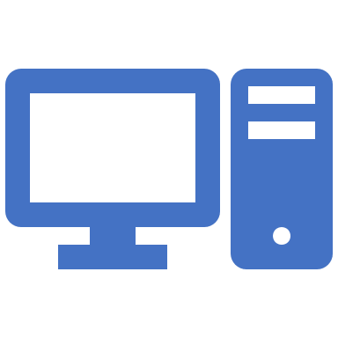
File Server Access Portal – Key Benefits
VPN Replacement
No Cloud Replication
Offline access
Fast and Easy
Centralized Control and Governance
Notes:
Access file server data anywhere without a VPN
Data control – Keep the data on your file server without cloud replication. Maintain LAN style file locking and NTFS permissions.
Offline access – access data without network connections
Performance – faster and easier to use than a VPN. Works on slow and high latency networks
Governance – Auditing, reporting, notifications, device management, etc…

Slide 9
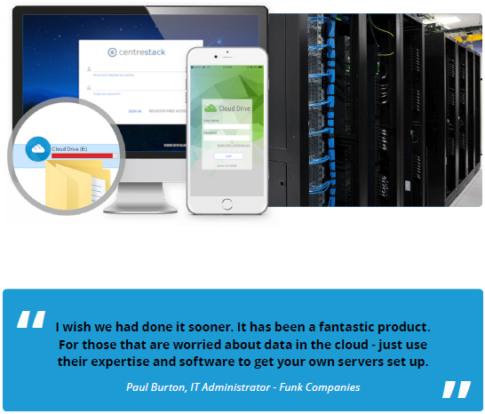
File Server Access Portal Success Story
MSP managing file servers on customer premises
Alternatives Considered: OneDrive, Dropbox, Google Drive
Previous Solutions: VPN, Remote Desktop
Use Cases: Central File Repository, Direct File Sharing, Remote File Sharing
“It’s the best of both worlds for us - we have 100% control with CentreStack + 100% control with our servers!” said Paul Burton, IT Administrator - Funk Companies.
The ease of access has been the biggest improvement in the day-to-day for Funk Companies and their clients. Funk’s clients don’t have to rely on a VPN or company computers to access their files securely. Anyone can now simply go into a URL and login to access their files remotely, from any device.

Slide 10
File Server Migration
File Server Replacement
Retire Windows File Servers
Accelerate Cloud Migration
NAS Device Support

Slide 11
File Server Migration Needs
File server maintenance and upgrades can be expensive
Customers typically approach their MSPs about cloud solutions and migration when it’s time to pay for server upgrades
MSPs tend to wait for these upgrade cycles to introduce options like CentreStack
Cloud migration can be disruptive and expensive
Notes:
Key phrases: cloud file servers, file server replacement, reduce file server costs, cloud enable file servers, multi-site collaboration, remote offices, cloud migration, file server retirement, remote access, sharepoint alternative, dropbox alternative, onedrive alternative

Slide 12
File Server Migration Benefits
Migration costs go to zero. Just unplug the file server at end of life and continue using the cloud replica with no change to daily operations.
Eliminate the disruption of cloud migration. Keep using the file server as you always have. Nothing needs to change. Unplug the file server when confident or keep it around as a local gateway.
Reduce management and maintenance costs even before the upgrade.
Reduce VPN tickets now.
Minimize downtime and disruption
Enhanced data management and access controls
Reduce risk with enhanced security, control and compliance
Provide remote access and collaboration features without losing control

Slide 13
File Server Replacement Success Story
Previous Solutions Include:
SharePoint & OneDrive
Egnyte
Soonr
Google Drive
“With CentreStack we’re on a weekly release cycle. We’ve gotten more accomplished in feature requests and bug fixes with them in 2 years than we did in 9 years with all the other platforms,” said Stephen.

Slide 14
Office 365 Integration
Use Existing Storage & O365
O365 Single Signon with SAML
Maintain Data Control
Regulatory Compliance
Notes:
Key phrases: O365 integration, alternate storage for O365, office 365 storage, backup o365, o365 data control, Office Online storage, office online alternate storage, office online storage options, o365 storage options
Common Verticals: Healthcare, Finance, Legal, Accounting

Slide 15
Office 365 Integration Needs
Using Office Online
Need backup of Office365 data
Need to store data in non-Microsoft data center
Notes:
Using Office Online
Prefer not to store company data on Microsoft’s servers
Still need to leverage O365 applications
Need a backup of O365 data (apps, sharepoint, onedrive)

Slide 16
Office 365 Integration Benefits
Edit CentreStack Docs with Office Online
1
Auto-Save redirected to CentreStack storage
2
Team Folder -> SharePoint Site
3
Team Folder -> OneDrive
4
Notes:
Open O365 docs in CentreStack browser client and they are auto-saved back to the CS location.
Team folder backup → mount SharePoint\OneDrive folder and backup

Slide 17
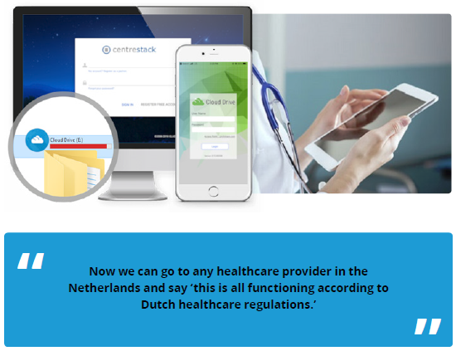
Office 365 Integration Success Story
Previous Solutions Include:
SharePoint & OneDrive
Egnyte
Soonr
Google Drive
“CentreStack solves the problem of easy data storage with Office 365. With CentreStack integration, the Office 365 autosave feature can be set to save on any file server that you choose, not just the Microsoft cloud, as is the default with Office 365.
Notes:
Customer site can be found at https://www.storxs.com

Slide 18
CentreStack vs Dropbox
Channel focused
Managed Access
File Servers and/or Cloud
Technical Highlights
Mapped drives
File locking
Sync on-demand
NTFS & AD integration
Strategic Highlights
Increased margins
Customer Benefits
Easy migration
MSP Benefits
Increased control
Own the service
White labeled
More security and control
Better performance
Familiar interfaces
Notes:
Dropbox is a great platform that is easy to use with a beautiful interface. However, they have a different focus from CentreStack.
MSPs move away from Dropbox because they make more money and have more control over who has access to the data and what they can do with it. Their customers also get a better user experience because of the familiar interfaces and performance enhancements.
Typical objections:
How do I compete with a free offering.
Raise and block by pointing out the importance of selling managed access as opposed to remote access or sync and share.
But my users just want something easy and they’re already using it.
Raise and block by pointing out that CS provides the ease of use without sacrificing control and security and provides more margins, performance and features. But the ultimate key is selling managed access as a service offered by their trusted advisor, instead of trying to position CS as just a Dropbox replacement. CentreStack is going to manage all user access in all situations.

Slide 19
CentreStack vs SharePoint
Channel focused
Managed Access
File Servers and/or Cloud
Technical Highlights
Mapped drives
File locking
Sync on-demand
NTFS & AD integration
Strategic Highlights
Support LOB apps
Customer Benefits
Windows style sharing
MSP Benefits
Increased control
Own the service
White labeled
Familiar drive access
Less training
Notes:
There a few typical drawbacks to SharePoint that CentreStack can resolve:
Difficult to setup and initial migration can require significant effort
Users have to be trained to use sites, libraries and web-based collaboration
Line of business applications may prevent migration of some data to SharePoint
Typical objections SharePoint replacement include:
Already paying for SharePoint (or OneDrive) – block this objection by raising it and pointing out that it becomes another data island.
Already have data in SharePoint – raise and block objection by pointing out our integration with SharePoint sites and libraries. CentreStack is a valuable add-on to or replacement for SharePoint

Slide 20
CentreStack vs Egnyte
Channel focused
Managed Access
Technical Highlights
Mapped drives
File locking
Sync on-demand
NTFS & AD integration
Strategic Highlights
Increased margins
Customer Benefits
No third party servers
MSP Benefits
Increased control
Data sovereignty
White labeled
More security and control
Better performance
Familiar interfaces
Notes:
Like most services, Egnyte is focused on moving customers into their cloud environment.
This creates the following problems that CS can resolve:

Slide 21
CentreStack vs Anchor
Channel focused
Managed Access
File Servers and/or Cloud
Technical Highlights
Mapped drives
File locking
Sync on-demand
NTFS & AD integration
Strategic Highlights
Increased margins
Customer Benefits
Easy migration
MSP Benefits
Increased control
Own the service
White labeled
More security and control
Better performance
Familiar interfaces
Notes:
Dropbox is a great platform that is easy to use with a beautiful interface. However, they have a different focus from CentreStack.

Slide 22
CentreStack vs Others
Channel focused
Managed Access
File Servers and/or Cloud
Technical Highlights
Mapped drives
File locking
Sync on-demand
NTFS & AD integration
Strategic Highlights
Increased margins
Customer Benefits
Easy migration
MSP Benefits
Increased control
Own the service
White labeled
More security and control
Better performance
Familiar interfaces
Notes:
Dropbox is a great platform that is easy to use with a beautiful interface. However, they have a different focus from CentreStack.

